Slide 1


Department of BES-1
DESIGN OF DATA STRUCTURES
24SC1203
Topic:
SPLAY TREES
Session - 33

Slide 2



AIM OF THE SESSION
To familiarize students with the basic concept of Splay Trees
INSTRUCTIONAL OBJECTIVES
This Session is designed to:
Demonstrate Splay Tree
Describe the different types of rotations performed on the splay tree
List out the advantages of Splay Trees
Describe the Time Complexities of Splay Trees
LEARNING OUTCOMES
At the end of this session, you should be able to:
Define Splay Tree.
Describe the Advantages of using the Splay Trees in Real Time
Summarize the Splay Tree Concept

Slide 3
SESSION INTRODUCTION
What is Splay Tree?
  Splay trees are the self-balancing or self-adjusted binary search trees
    A splay tree is a self-balancing tree, like AVL and Red-Black Trees.
    Splay Tree has one extra property that makes it unique is splaying.
    A splay tree contains the same operations as a Binary Search Tree, i.e., Insertion, Deletion and Searching, but it also contains one more operation, i.e., Splaying. So, all the operations in the splay tree are followed by splaying.
    The splay tree can be defined as the self-adjusted tree in which any operation performed on the element would rearrange the tree so that the element on which operation has been performed becomes the root node of the tree.

Slide 4
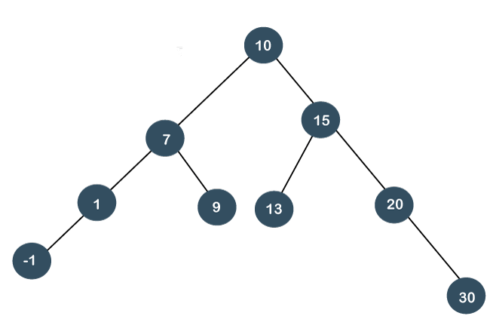
SESSION DESCRIPTION
Example Splay Tree Operations
Splay trees are not strictly balanced trees, but they are roughly balanced trees. Let's understand the search operation in the splay-tree
Suppose we want to search 7 element in the tree, which is shown below

Slide 5
Example Splay Tree Operations Cont…
SESSION DESCRIPTION (Cont..)
To search any element in the splay tree, first, we will perform the standard binary search tree operation. As 7 is less than 10 so we will come to the left of the root node.
After performing the search operation, we need to perform splaying.
Here splaying means that the operation that we are performing on any element should become the root node after performing some rearrangements.
The rearrangement of the tree will be done through the rotations

Slide 6
SESSION DESCRIPTION (Cont..)
Splay Tree Rotations
There are six types of rotations used for splaying
  Zig rotation (Right rotation)
  Zag rotation (Left rotation)
  Zig zag (Zig followed by zag)
  Zag zig (Zag followed by zig)
  Zig zig (two right rotations)
  Zag zag (two left rotations)

Slide 7
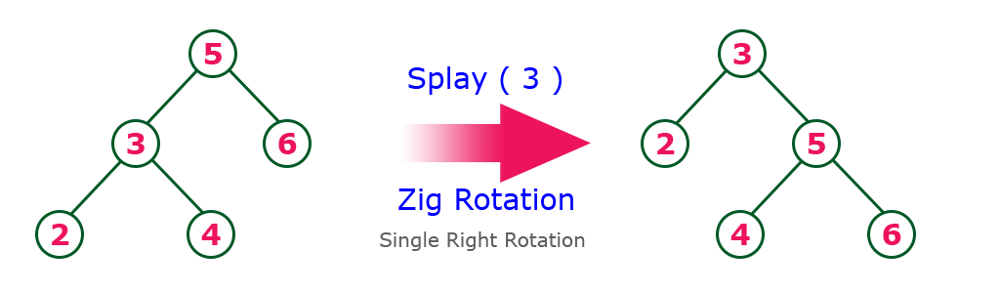
EXAMPLES
Zig Rotation
The Zig Rotation in splay tree is similar to the single right rotation in AVL Tree rotations. In zig rotation, every node moves one position to the right from its current position. Consider the following example...

Slide 8
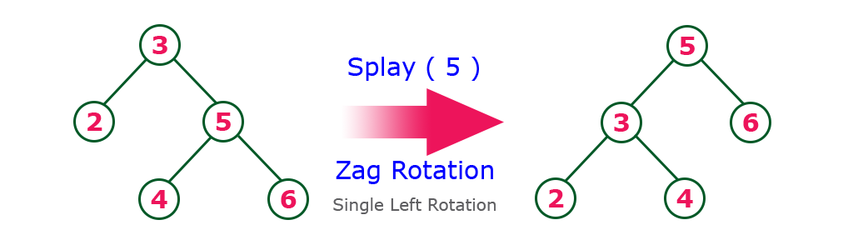
EXAMPLES
Zag Rotation
The Zag Rotation in splay tree is similar to the single left rotation in AVL Tree rotations. In zag rotation, every node moves one position to the left from its current position. Consider the following example...

Slide 9
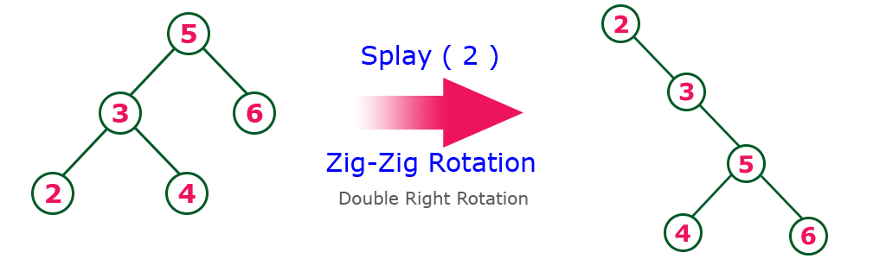
EXAMPLES
Zig-Zig Rotation
The Zig-Zig Rotation in splay tree is a double zig rotation. In zig-zig rotation, every node moves two positions to the right from its current position. Consider the following example...

Slide 10
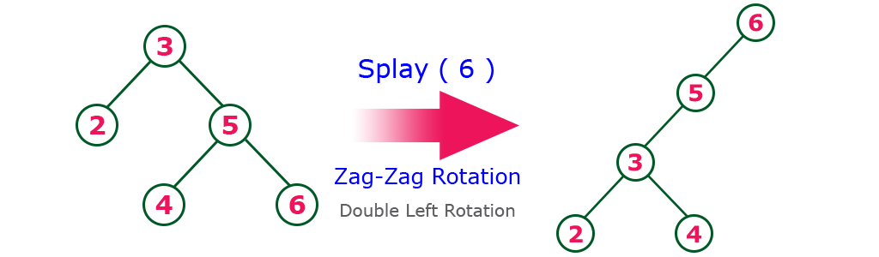
EXAMPLES
Zag-Zag Rotation
The Zag-Zag Rotation in splay tree is a double zag rotation. In zag-zag rotation, every node moves two positions to the left from its current position. Consider the following example...

Slide 11
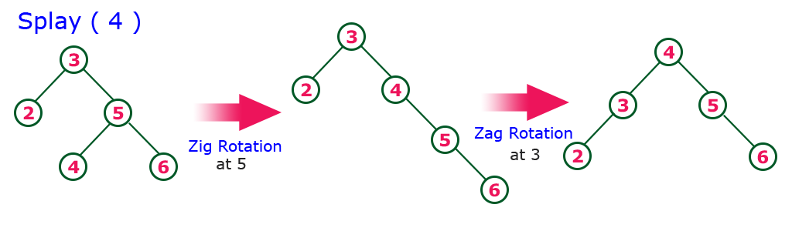
EXAMPLES
Zig-Zag Rotation
The Zig-Zag Rotation in splay tree is a sequence of zig rotation followed by zag rotation. In zig-zag rotation, every node moves one position to the right followed by one position to the left from its current position. Consider the following example...

Slide 12
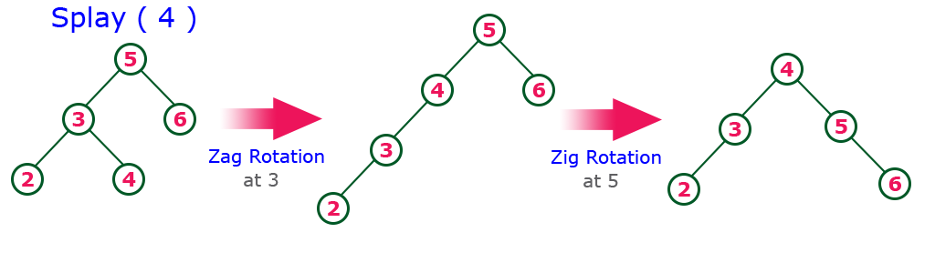
EXAMPLES
Zag-Zig Rotation
The Zag-Zig Rotation in splay tree is a sequence of zag rotation followed by zig rotation. In zag-zig rotation, every node moves one position to the left followed by one position to the right from its current position. Consider the following example...

Slide 13
SPLAY TREE EXAMPLE
Construct a Splay Tree with the following elements and Explain the rotations in detail
12,43,33,26,97,104,11,0

Slide 14
SUMMARY
A splay tree is a binary search tree with the additional property that recently accessed elements are quick to access again
All normal operations on a binary search tree are combined with one basic operation, called splaying. Splaying the tree for a certain element rearranges the tree so that the element is placed at the root of the tree
One way to do this with the basic search operation is to first perform a standard binary tree search for the element in question, and then use tree rotations in a specific fashion to bring the element to the top
  The rearrangement of the tree will be done through the six types of rotations Zig rotation (Right rotation), Zag rotation (Left rotation), Zig zag (Zig followed by zag), Zag zig (Zag followed by zig), Zig zig (two right rotations), and Zag zag (two left rotations)

Slide 15
SELF-ASSESSMENT QUESTIONS
A splay tree is best described as what type of data structure?
Binary search tree
Positional List
Circular list
Multi-dimensional array
Which is not a rotation in splay tree?
Zig-zig
Zag-zag
Zig-zag-zig
zig

Slide 16
TERMINAL QUESTIONS
1. Describe Splay Trees with examples.
2. List out the different rotations used for splaying in Splay Trees.
3. Analyze the advantages of Splay Trees compare to Binary Search Trees.
4. Summarize the Splay Trees with features.

Slide 17
REFERENCES FOR FURTHER LEARNING OF THE SESSION
Reference Books:
1. A.V.Aho, J.E. Hopcroft, and J.D. Ullman, "Data Structures And Algorithms", Pearson Education, First Edition Reprint 2003
2. Horowitz, Sahni, Anderson Freed, "Fundamentals of datastructures in C", Second Edition-2007
3. R.F. Gilberg, B.A. Forouzan, "Data Structures", Second Edition, Thomson India Edition, 2005
Sites and Web links:
1. https://en.wikipedia.org/wiki/Splay_tree
2. https://www.javatpoint.com/splay-tree
3. https://www.scaler.com/topics/data-structures/splay-tree/

Slide 18
THANK YOU
Team – Design of Data Structures

